Slide 1
Software Engineering
CS20006
Lecture 09
Statechart Diagrams

Slide 2
Lecture #10
What is a Statechart diagram?
Basic components in a state-chart diagram and their notations
Difference between a state-chart diagram and an activity diagram
Example: Process Order in OLP system
Example: Course Registration system

Slide 3
What is a Statechart Diagram?
A state-chart diagram is used to model the dynamic aspects of the system. The basic idea is same as the state machine in Finite Automata
We can draw state diagrams for each object involved in the system
An object may be in several states of its life time. When a message arrives to an object (event) it undergoes certain operations (action) or changes its state
A state diagram shows how an object will react to the arrival of an event
  Each reaction may be a sequence of actions, possibly accompanied by a transition from one named state to another
  An event represents the receipt of a signal, or the effect of an operation call
  An action represents the sending of a signal, or the call of an operation

Slide 4
General Structure of a State-Chart Diagram
A state-chart diagram typically look like this

Slide 5
Basic Components in a State-Chart Diagram
Two basic elements are there
  Rounded rectangle box representing the state
  Labeled arrow indicating the transitions
    Here, event is the message that is sent
    guard condition is the Boolean expression of attribute values that allows a state transition only if the condition is true
    An action is the behavior that occurs when the state transition occurs

Slide 6
Detail State in a State-Chart Diagram
Detail of state is shown below
Entry actions: that are common to every incoming transition
Exit actions: that are common to every outgoing transition
Self-transition: action within the state itself
If there is no guard or if the guard is true, then for the event the actions will be followed and it can enter [exit] to [from] a state or remain in the same state

Slide 7
Example: Stack Machine

Slide 8
State Diagram vs. Activity Diagram
Similarity
  An activity diagram is a special case of a statechart diagram in which all or most of states are activity states and all or most of the transitions are triggered by completion of activities in the preceding state. Thus, both statechart and activity diagrams are useful in modeling the life time of the object
Differences
  An activity diagram shows flow control from activity to activity, a statechart diagram shows flow of control from state to state
  An activity is a set of operation to manipulate objects. On the other hand, a state is an instance of an object. An object change its state when some event trigger on it
  An activity diagram is used to model the behavioral view of a use case, whereas a statechart diagram is used to model the dynamic view of objects, which are underlying within a use case

Slide 9
Example: Activity Diagram
Suppose, the use case “Process Order” in the OLP system. The activity diagram look like:

Slide 10
Example: Statechart Diagram
In the “Process Order” use case, the object that is being manipulated is, namely, ORDER. So, a state diagram can be drawn to model how the object changes its state in this particular use case

Slide 11
Statechart Diagram: Another Example
Suppose, a COURSE is an object in a usual “Course Registration” use case (consider the SEIIT). Following is a state diagram to model the behavioral view of the object COURSE

Slide 12
Advantages of Statechart Diagram
A statechart diagram is used to model how the state of an object changes in its life time
Statechart diagrams are good describing how the behavior of an object change across several use case executions
However, if we are interested in modeling some behavior that involves the several objects collaborating with each other, the statechart diagram is not appropriate

Slide 13
How to design class given a statechart?

Slide 14
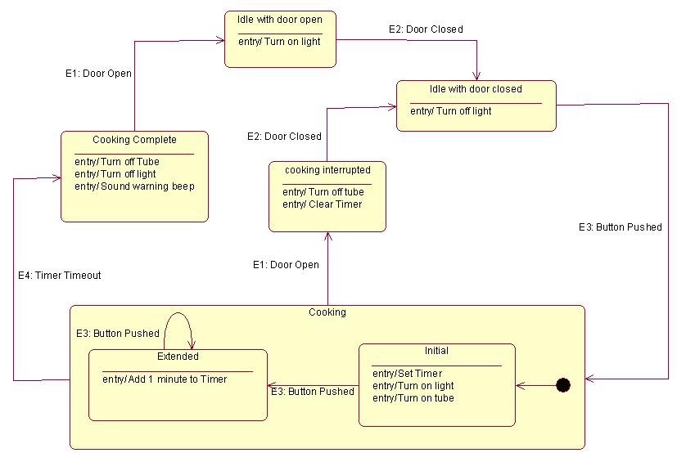
Example: Microwave Oven

Slide 15
Designing Class

Slide 16
State Attributes
class Microwave {
State : IdleWithDoorOpen, IdleWithDoorClose, Initial,
CookingInterupted, Extend, CookingCompleted;
State MyState;
Class Tube p;
Class Light l;
Class Timer t;
Class Beeper b;
Class Door d;
        Contd. on

Slide 17
Internal Actions
class Microwave {
State : IdleWithDoorOpen, IdleWithDoorClose, Initial,
CookingInterupted, Extend, CookingCompleted;
State MyState;
void TurnOnLight();
void TurnOffLight ();
void TurnOffTube();
void TurnOnTube();
void ClearTimer();
void SetTimer();
void SoundWarningBeep();
void Add1MinuteToTimer();
void OnEntry();

Slide 18
Events Actions
class Microwave {
    void DoorOpen();
    void DoorClosed();
    void ButtonPushed();
    void TimerTimeout();
    }

Slide 19
Defining OnEntry()
void Microwave :: OnEntry () {
switch (MyState) {
case IdleWithDoorOpen:
TurnOnLight();
break;
case IdleWithDoorClose:
TurnOffLight();
break;
case Initial:
SetTimer();
TurnOnLight();
TurnOnTube();
break;
14. case Extended :
15. Add1MinuteToTimer();
16. break;
17. case CookingInterupted:
18. TurnOffTube();
19. ClearTimer();
20. break;
21. case CookingCompleted:
22. TurnOffTube();
23. TurnOffLight();
24. SoundWarningBeep();
25. break;
26. default : // Should signal error here..
}

Slide 20
Defining DoorOpen()
void Microwave :: DoorOpen () {
switch (MyState) {
case IdleWithDoorOpen:
break;
case IdleWithDoorClose:
MyState = IdlewithDoorOpen;
OnEntry();
break;
case Initial:
MyState = cookingInterupted;
OnEntry();
break;
case Extended :
MyState = CookingInterupted;
OnEntry();
break;
case CookingInterupted:
break;
case CookingCompleted:
MyState = IdlewithDoorOpen;
OnEntry();
break;
default : // Should signal error here..
}

Slide 21
More features in Statechart Diagram

Slide 22
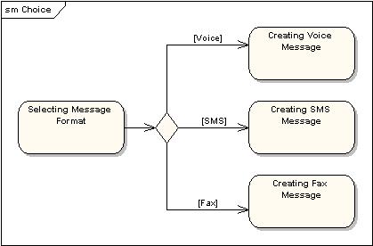
Choice Pseudo-State
A choice pseudo-state is shown as a diamond with one transition arriving and two or more transitions leaving. The following diagram shows that whichever state is arrived at after the choice pseudo-state is dependent on the message format selected during execution of the previous state

Slide 23
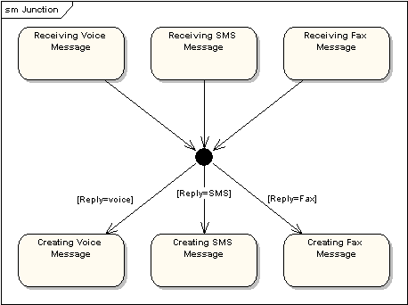
Choice Junction-State
Junction pseudo-states are used to chain together multiple transitions. A single junction can have one or more incoming and one or more outgoing transitions and a guard can be applied to each transition. Junctions are semantic-free; a junction which splits an incoming transition into multiple outgoing transitions realizes a static conditional branch as opposed to a choice pseudo-state which realizes a dynamic conditional branch

Slide 24
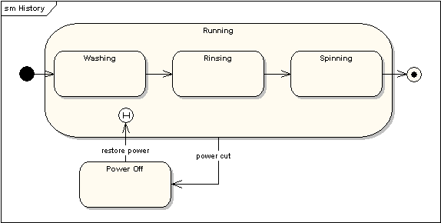
History State
A History State is used to remember the previous state of a state machine when it was interrupted. The following diagram illustrates the use of history states. The example is a state machine belonging to a washing machine

Slide 25
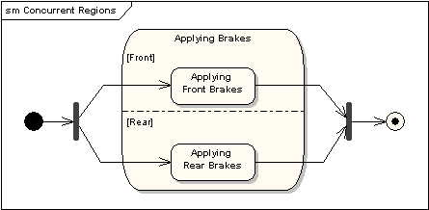
Concurrent State
A state may be divided into regions containing sub-states that exist and execute concurrently. The example below shows that within the state "Applying Brakes", the front and rear brakes will be operating simultaneously and independently. Notice the use of fork and join pseudo-states rather than choice and merge pseudo-states. These symbols are used to synchronize the concurrent threads

Slide 26
A State Machine with Three States

Slide 27
Problems to Ponder
Draw the statechart diagrams of
  Book, Borrower and Reserve in LIS
Given statechart diagram of Book, how you can implement its class?

Slide 28
Problems to Ponder
Obtain the class for the following state machine?

